Slide 1
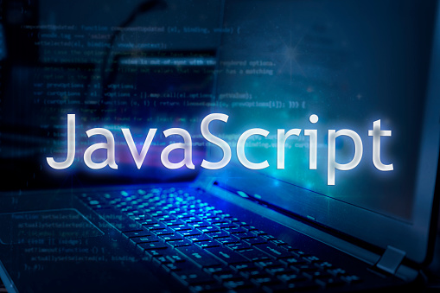

Slide 2
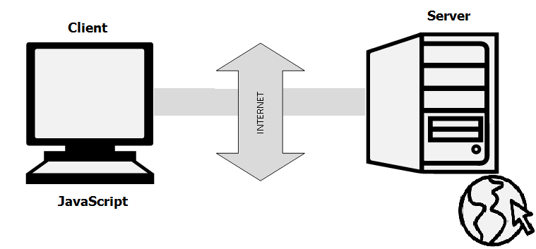
What is JavaScript?
JavaScript is a cross-platform, object-oriented scripting language used to make webpages interactive

Slide 3
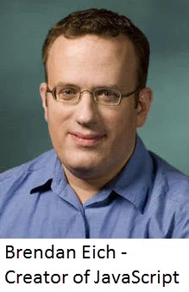
JavaScript History
JavaScript was developed by Brendan Eich in 1995, which
appeared in Netscape, a popular browser of that time.

Slide 4
How to Run JavaScript?
Being a scripting language, JavaScript cannot run on its own. In fact, the browser is responsible for running JavaScript code. When a user requests an HTML page with JavaScript in it, the script is sent to the browser and it is up to the browser to execute it.

Slide 5
Tools You Need
You can use a text editor of your choice including Notepad++, Visual Studio Code, Sublime Text, Atom or any other text editor you are comfortable with. You can use any web browser including Google Chrome, Firefox, Microsoft Edge, Internet Explorer etc.

Slide 6
A Simple JavaScript Program
You should place all your JavaScript code within <script> tags (<script> and </script>) if you are keeping your JavaScript code within the HTML document itself.
<script type="text/ javascript">

Slide 7
Simple Code for example
<html>
<head>
<title>My First JavaScript code</title>
<script type="text/java script">
alert("Hello World!");
</script>
</head>
<body>
</body>
</html>

Slide 8
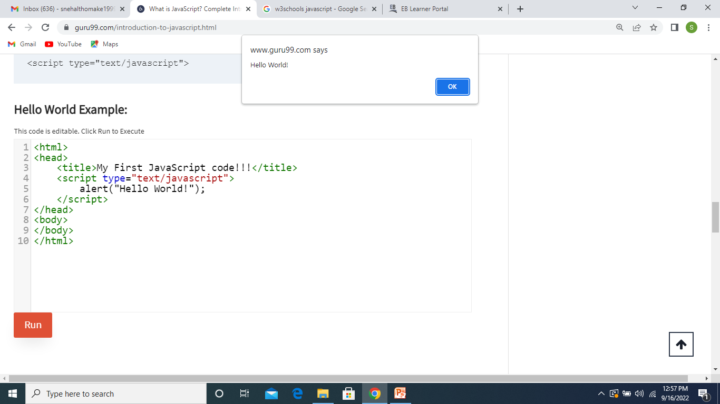
After Run the code

Slide 9
Advantages of JavaScript
Speed
Simplicity
Server Load
Rich Interfaces
Extended Functionality
Versatility

Slide 10
Disadvantages of JavaScript
Client-side Security.
Lack of Debugging Facility
Single Inheritance
Sluggish Bitwise Function

